Slide 1


hoare's partition
Mohammed adnan
224307

Slide 2
Introduction and problem
Hoare partition is an algorithm that is used to partition an array about a pivot. All elements smaller than the pivot are on it's left (in any order) and all elements greater than the pivot are on it's right (in any order).
Hoare partition is used in Quicksort which is an efficient, comparison-based sorting algorithm that works by dividing an array into smaller subarrays, sorting those subarrays, and then combining them to produce a fully sorted array. The partitioning step, which is often referred to as "Hoare's Partition Scheme," is one of the key components of quicksort.

Slide 3
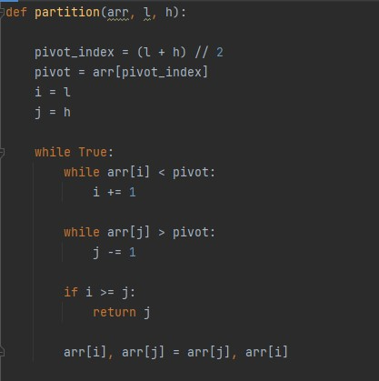
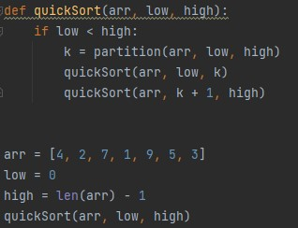
Initialize two pointers L and H where L is for the element at the smallest index and the other, H is for the element at the highest index.
The pivot in the middle of the array.
Do this: Keep increasing i while arr[i] < pivot. Keep decreasing j while arr[j] > pivot. If i >= j, return j.
else swap(arr[i], arr[j]);

Slide 4
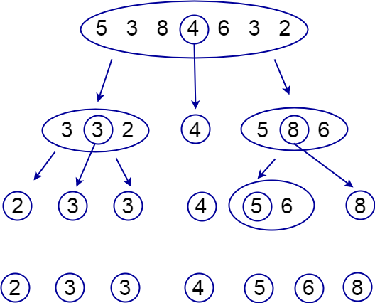

Slide 5
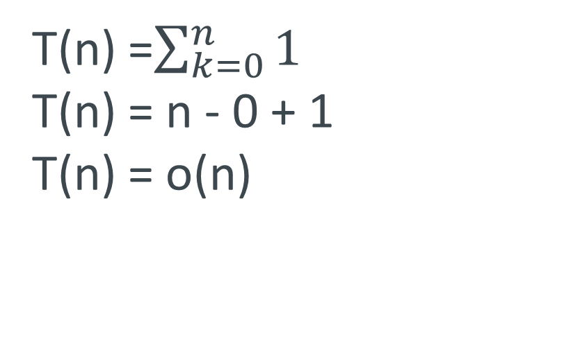
Time Complexity of Hoare Partition
T(n) =$\sum_{k=0}^{n}{1}$
T(n) = n - 0 + 1
T(n) = o(n)

Slide 6
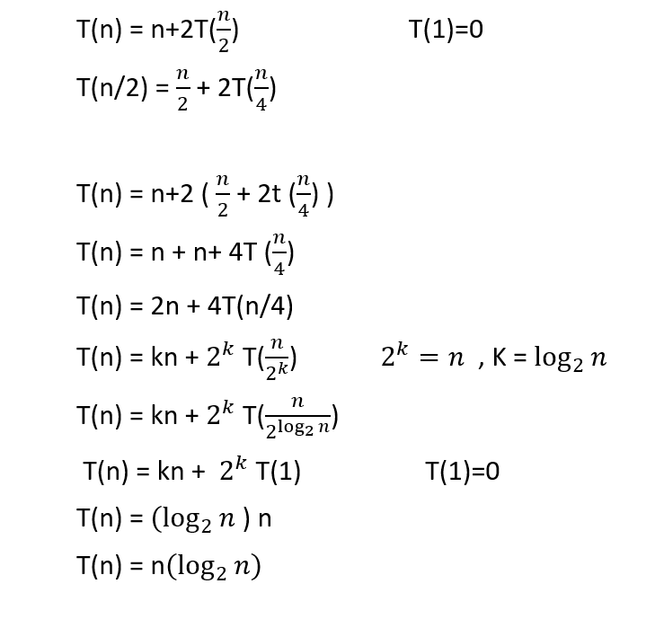
Time Complexity of Hoare Partition with the quick sort

Slide 7

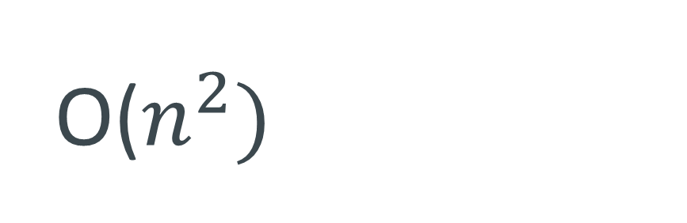

Average case
Worst case
$$n(\log_{2}{n})$$
O($n^{2})$
Best case
$$n(\log_{2}{n})$$

Slide 8
Thank you

